Slide 1
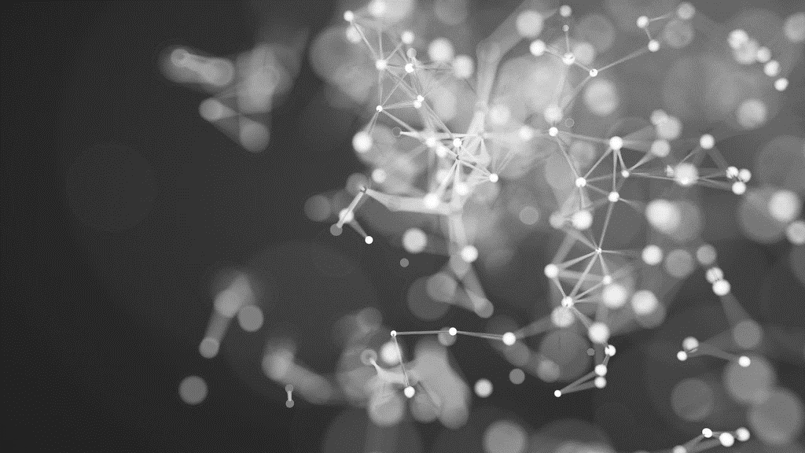
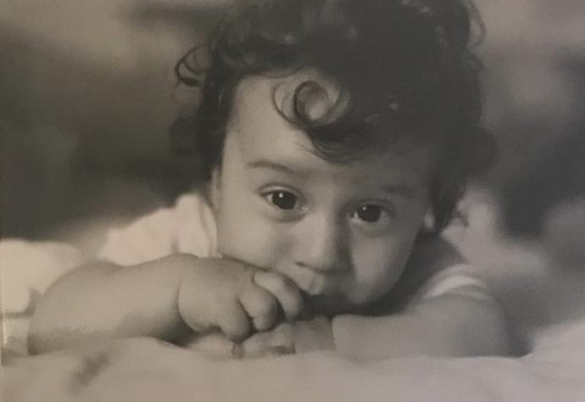

GROUP 2
Happy Manaloto
Jan Fink

Slide 2
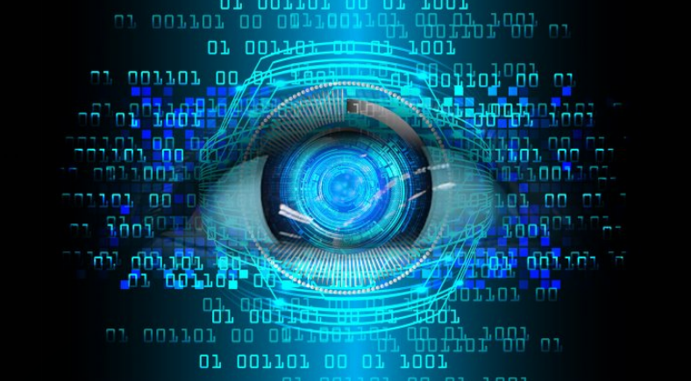
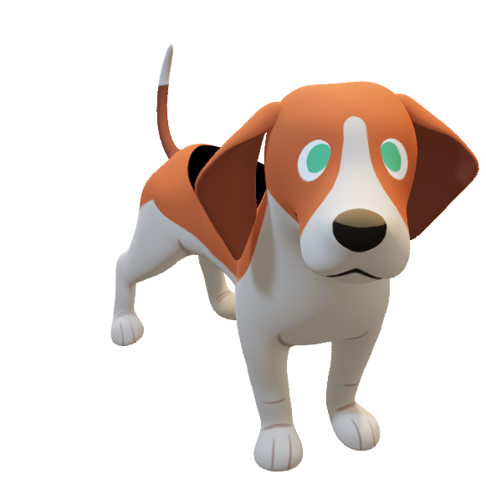
DEEP LEARNING FOR COMPUTER VISION
Notes:
We may be babies when it comes to Deep Learning at the moment, but we stand tall after being able to harness the power of MobileNetV2 to recognize just 10 tiny classes in the CIFAR-10 dataset.
MobileNetV2 is a neural network trained on millions of images, and fine-tuned it
Because in deep learning, it's not about starting from scratch... it's about standing on the shoulders of giants.

Slide 3
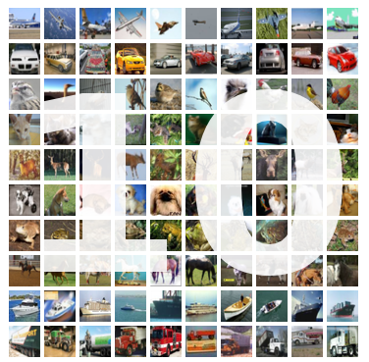
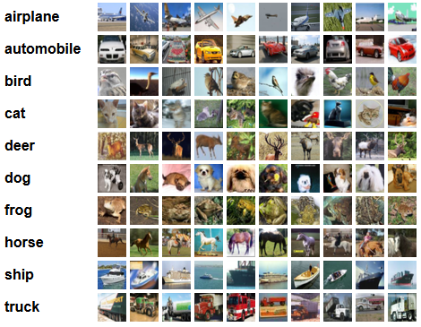
CIFAR -
Notes:
Deep Learning CIFAR-10 Image Classification with Transfer Learning Using TensorFlow, MobileNetV2, and Gradio
CIFAR stands for Canadian Institute for Advanced Research
CIFAR-10: 60,000 32×32 color images across 10 categories
50,000 for training, 10,000 for testing
Classes: airplane, automobile, bird, cat, deer, dog, frog, horse, ship, truck

Slide 4
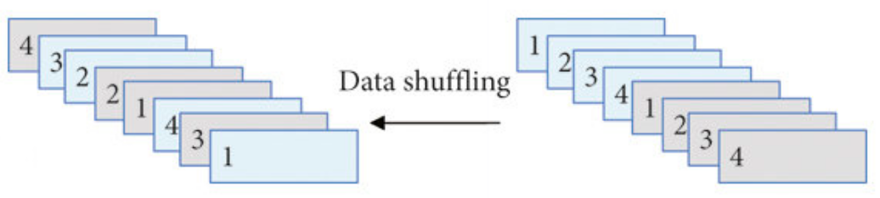
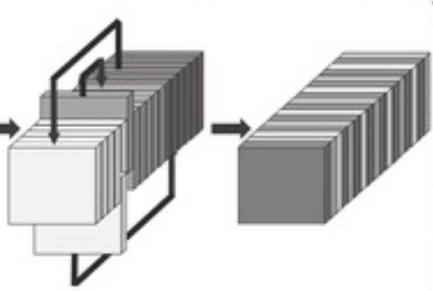
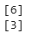
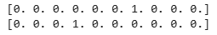
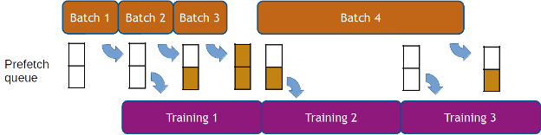
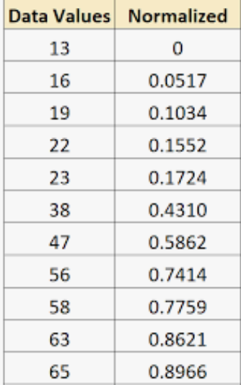
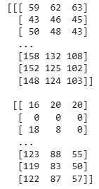
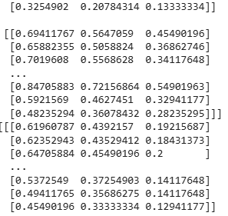
Resize to 160x160 for MobileNetV2
tf.data pipeline for performance
32 x 32
160 x 160
One-hot encoding of labels
DATA
PREPROCESSING
Normalization
Notes:
. Resizing images to match MobileNetV2 input
Why: MobileNetV2 expects input images of 96x96 to 224x224 pixels.
CIFAR-10 images are only 32x32, thus the need to upscale them.
Without resizing, the model won’t accept the input shape.
🎨 2. Normalizing pixel values to [0, 1]
Why: Neural networks train better with smaller, consistent input values.
CIFAR-10 pixel range is 0–255 → divide by 255 to scale between 0 and 1.
This speeds up training and improves convergence.
🏷️ 3. One-hot encoding labels
Why: CIFAR-10 labels are class indices (e.g., 3 = cat).
Models using categorical_crossentropy loss need one-hot encoded labels like [0, 0, 0, 1, 0, ...].
Essential for multi-class classification.
⚙️ 4. Efficient data loading with tf.data.Dataset
Why: Raw loading is slow. tf.data.Dataset enables:
🔀 Shuffling – Prevents model from learning the order of data (helps generalization).
📦 Batching – Trains on small groups of images at a time (e.g., 32 or 64), improving memory usage.
🚀 Prefetching – Loads the next batch while the model trains on the current one, speeding up training.

Slide 5




Convolutional NEURAL NETWORK ARCHITECTURE
Conv2D (32 filters, 3x3) + ReLU + MaxPooling
INPUT: (32, 32, 3)
Conv2D
MAXpooling
Dense(128) + Dropout
Output: Dense(10)
INPUT
Dense(128, ReLU) + Dropout(0.3)
Softmax
Flatten
OUTPUT
Conv2D (64 filters, 3x3) + ReLU + MaxPooling
Notes:
We first implemented a custom CNN for CIFAR-10:
Conv2D (32 filters, 3x3) + ReLU + MaxPooling
Conv2D (64 filters, 3x3) + ReLU + MaxPooling
Flatten + Dense(128, ReLU) + Dropout(0.3)
Output: Dense(10, softmax)
This model served as a baseline before applying transfer learning.
Base model: MobileNetV2(weights='imagenet', include_top=False)
Added custom head:
Global Average Pooling Dense(128, activation='relu’)
Dropout(0.3) Dense(10, activation='softmax’)
Total layers: 158 (154 from base + 4 custom)

Slide 6
OPTIMIZATION TECHNIQUES
ADAM
CATEGORICAL CROSSENTROPY
ACCURACY
EARLY STOPPING
Notes:
Optimizer: Adam
Combines Momentum + RMSProp
Adapts learning rate per parameter
Faster and more stable convergence ✅ Great for noisy and sparse gradients (like images)
📉 Loss Function: Categorical Crossentropy
Used for multi-class classification (10 CIFAR-10 classes)
Compares predicted class probabilities vs one-hot labels 🔁 Guides the model in minimizing prediction error
📊 Metric: Accuracy
Percentage of correct predictions
Simple, intuitive performance measure ✅ Helps track model improvement over epochs
📌 Why this setup?
Suits image data + multiple classes
Efficient optimization with adaptive learning
Clear monitoring of performance
EarlyStopping(patience=3): Stops training early if val_accuracy doesn’t improve for 3 epochs.
restore_best_weights=True: Rolls back to the best model weights (prevents overfitting).

Slide 7
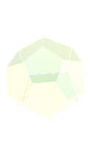
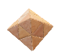
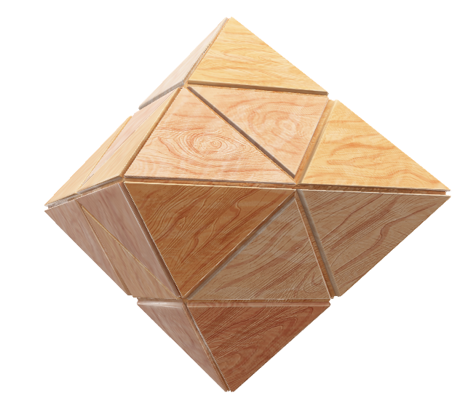


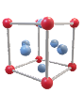
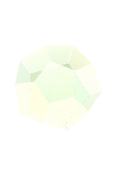
TRANSFER LEARNING
MobileNetV2
ImageNet: 1.4M images,
1000 classes
INPUT: (160, 160, 3)
MOBILENETv2
GAP
Dense(128) + Dropout
Output: Dense(10)
INPUT
Dense(128, ReLU) + Dropout(0.3)
Softmax
OUTPUT
GlobalAveragePooling
Notes:
Base model: MobileNetV2(weights='imagenet', include_top=False)
Added custom head:
Global Average Pooling Dense(128, activation='relu’)
Dropout(0.3) Dense(10, activation='softmax’)
Total layers: 158 (154 from base + 4 custom)
weights='imagenet' loads pre-trained weights (on ImageNet: 1.4M images, 1000 classes).
include_top=False removes the final classification layer (we'll add our own).
input_shape=(IMG_SIZE, IMG_SIZE, 3) sets the input size for CIFAR-10 (resized to 160x160 or 224x224, 3 channels for RGB).
🎯 Purpose: Use MobileNetV2 as a feature extractor, not a classifier.
Explanation:
Freezes all MobileNetV2 layers so they don’t get updated during training.
Saves time and prevents forgetting what it already learned from ImageNet.
base_model.output: Get the final feature maps from MobileNetV2.
GlobalAveragePooling2D():
Converts the feature maps (shape: H×W×C) to a single vector (1×1×C).
Reduces model size, prevents overfitting, and works better than Flatten() for CNNs.
Dense(128, activation='relu'): Adds a fully connected layer to learn new patterns.
Dropout(0.3): Randomly turns off 30% of neurons during training to reduce overfitting.
Dense(10, activation='softmax'): Final output layer with 10 nodes for the 10 CIFAR-10 classes.
Combines the input of MobileNetV2 and the new classification head into a complete

Slide 8
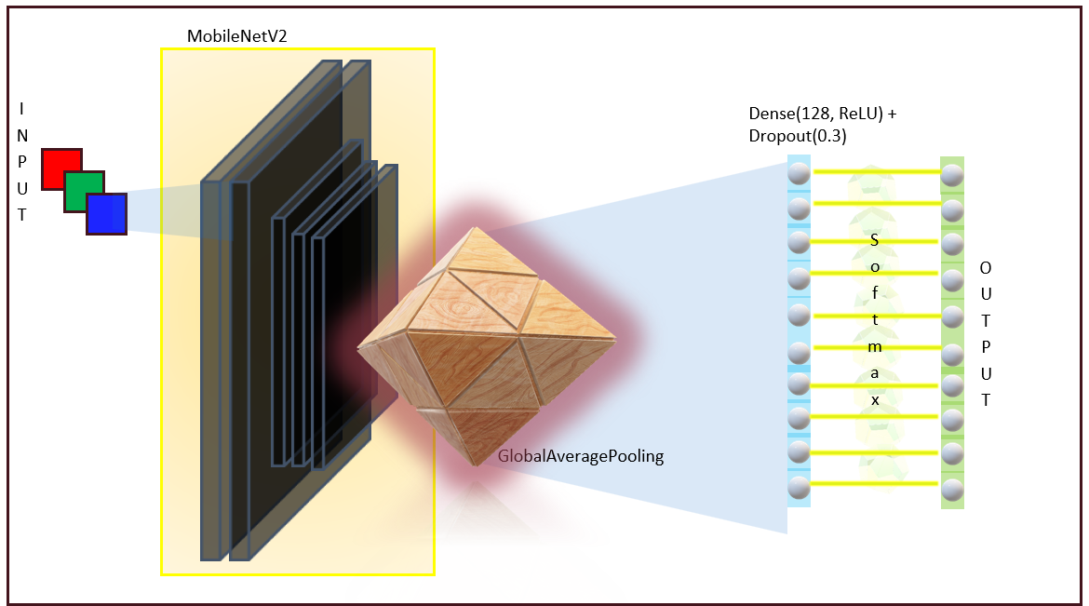
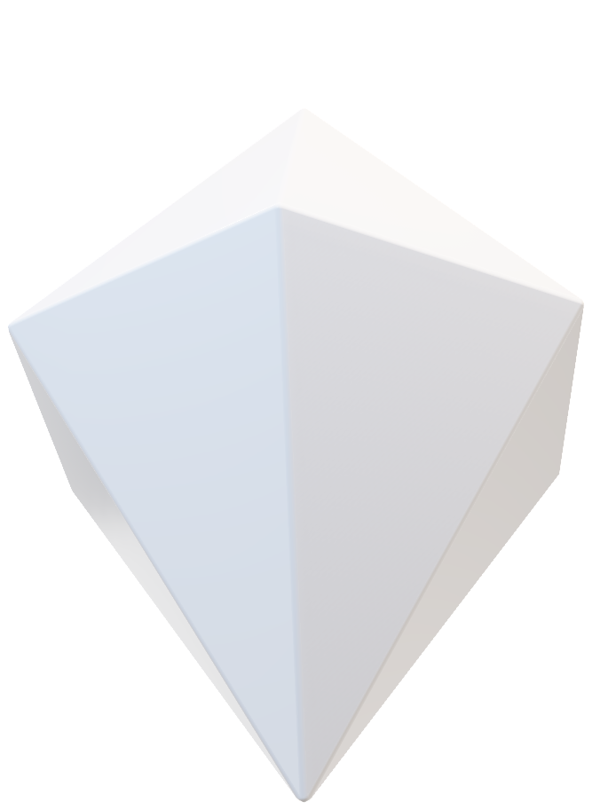
FINE TUNING
UNFREEZE THE DEEPER LEVELS FROM 100
Notes:
Base model: MobileNetV2(weights='imagenet', include_top=False)
Added custom head:
Global Average Pooling Dense(128, activation='relu’)
Dropout(0.3) Dense(10, activation='softmax’)
Total layers: 158 (154 from base + 4 custom)
weights='imagenet' loads pre-trained weights (on ImageNet: 1.4M images, 1000 classes).
include_top=False removes the final classification layer (we'll add our own).
input_shape=(IMG_SIZE, IMG_SIZE, 3) sets the input size for CIFAR-10 (resized to 160x160 or 224x224, 3 channels for RGB).
🎯 Purpose: Use MobileNetV2 as a feature extractor, not a classifier.
Explanation:
Freezes all MobileNetV2 layers so they don’t get updated during training.
Saves time and prevents forgetting what it already learned from ImageNet.
base_model.output: Get the final feature maps from MobileNetV2.
GlobalAveragePooling2D():
Converts the feature maps (shape: H×W×C) to a single vector (1×1×C).
Reduces model size, prevents overfitting, and works better than Flatten() for CNNs.
Dense(128, activation='relu'): Adds a fully connected layer to learn new patterns.
Dropout(0.3): Randomly turns off 30% of neurons during training to reduce overfitting.
Dense(10, activation='softmax'): Final output layer with 10 nodes for the 10 CIFAR-10 classes.
Combines the input of MobileNetV2 and the new classification head into a complete

Slide 9
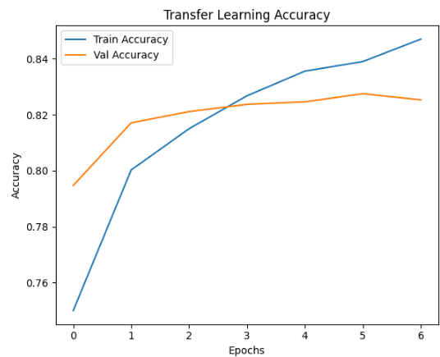
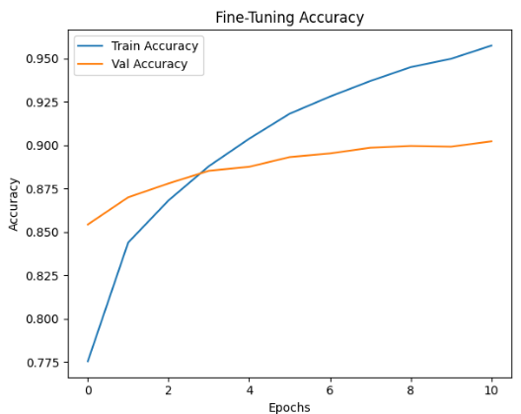
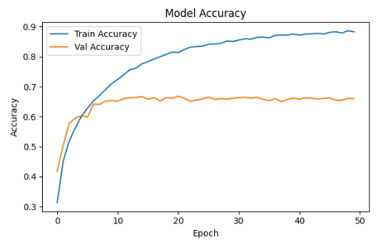
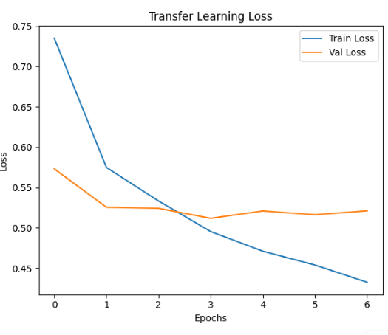
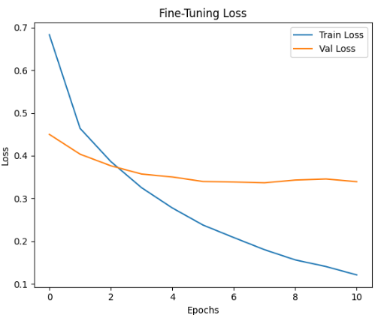
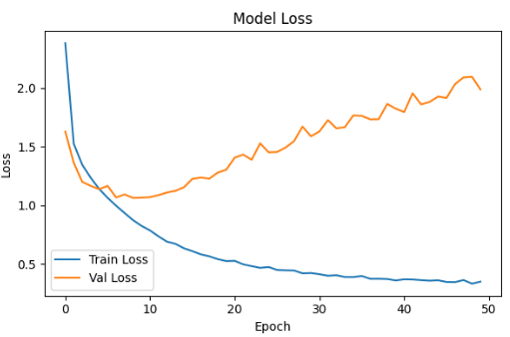
EVALUATION ON ACCURACIES AND LOSSES
CNN BASE MODEL
TRANSFER LEARNING
FINE TUNING
Notes:
Base model: MobileNetV2(weights='imagenet', include_top=False)
Added custom head:
Global Average Pooling Dense(128, activation='relu’)
Dropout(0.3) Dense(10, activation='softmax’)
Total layers: 158 (154 from base + 4 custom)
weights='imagenet' loads pre-trained weights (on ImageNet: 1.4M images, 1000 classes).
include_top=False removes the final classification layer (we'll add our own).
input_shape=(IMG_SIZE, IMG_SIZE, 3) sets the input size for CIFAR-10 (resized to 160x160 or 224x224, 3 channels for RGB).
🎯 Purpose: Use MobileNetV2 as a feature extractor, not a classifier.
Explanation:
Freezes all MobileNetV2 layers so they don’t get updated during training.
Saves time and prevents forgetting what it already learned from ImageNet.
base_model.output: Get the final feature maps from MobileNetV2.
GlobalAveragePooling2D():
Converts the feature maps (shape: H×W×C) to a single vector (1×1×C).
Reduces model size, prevents overfitting, and works better than Flatten() for CNNs.
Dense(128, activation='relu'): Adds a fully connected layer to learn new patterns.
Dropout(0.3): Randomly turns off 30% of neurons during training to reduce overfitting.
Dense(10, activation='softmax'): Final output layer with 10 nodes for the 10 CIFAR-10 classes.
Combines the input of MobileNetV2 and the new classification head into a complete

Slide 10
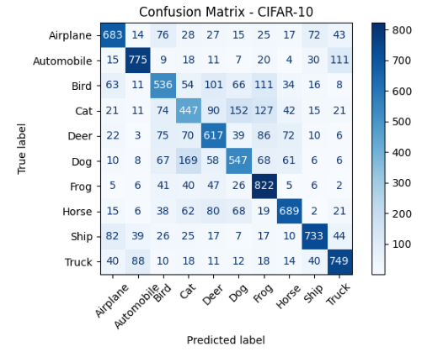
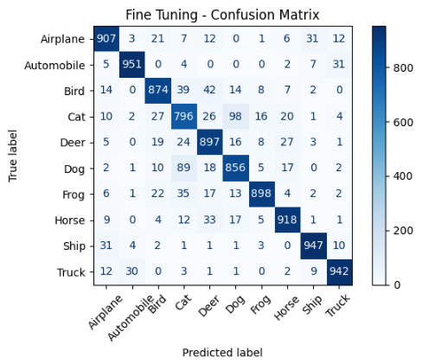
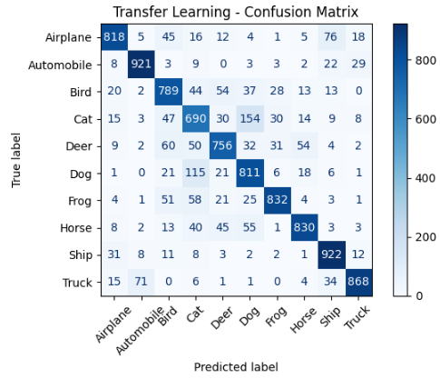
EVALUATION ON CONFUSION MATRICES
CNN BASE MODEL
FINE TUNING
TRANSFER LEARNING
Notes:
Base model: MobileNetV2(weights='imagenet', include_top=False)
Added custom head:
Global Average Pooling Dense(128, activation='relu’)
Dropout(0.3) Dense(10, activation='softmax’)
Total layers: 158 (154 from base + 4 custom)
weights='imagenet' loads pre-trained weights (on ImageNet: 1.4M images, 1000 classes).
include_top=False removes the final classification layer (we'll add our own).
input_shape=(IMG_SIZE, IMG_SIZE, 3) sets the input size for CIFAR-10 (resized to 160x160 or 224x224, 3 channels for RGB).
🎯 Purpose: Use MobileNetV2 as a feature extractor, not a classifier.
Explanation:
Freezes all MobileNetV2 layers so they don’t get updated during training.
Saves time and prevents forgetting what it already learned from ImageNet.
base_model.output: Get the final feature maps from MobileNetV2.
GlobalAveragePooling2D():
Converts the feature maps (shape: H×W×C) to a single vector (1×1×C).
Reduces model size, prevents overfitting, and works better than Flatten() for CNNs.
Dense(128, activation='relu'): Adds a fully connected layer to learn new patterns.
Dropout(0.3): Randomly turns off 30% of neurons during training to reduce overfitting.
Dense(10, activation='softmax'): Final output layer with 10 nodes for the 10 CIFAR-10 classes.
Combines the input of MobileNetV2 and the new classification head into a complete

Slide 11
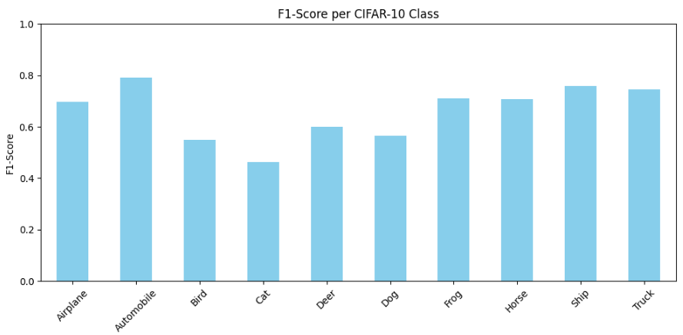
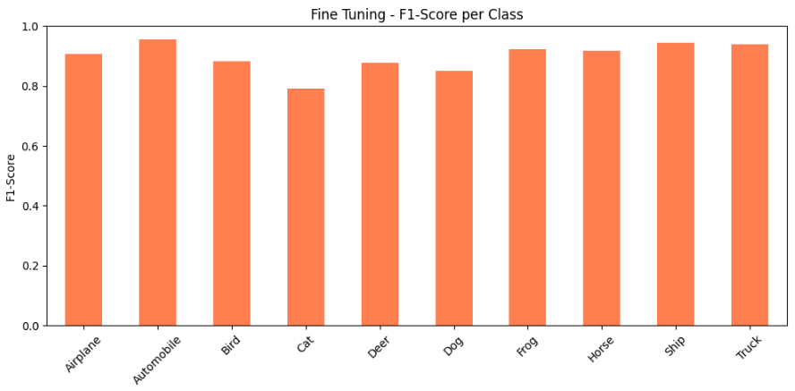
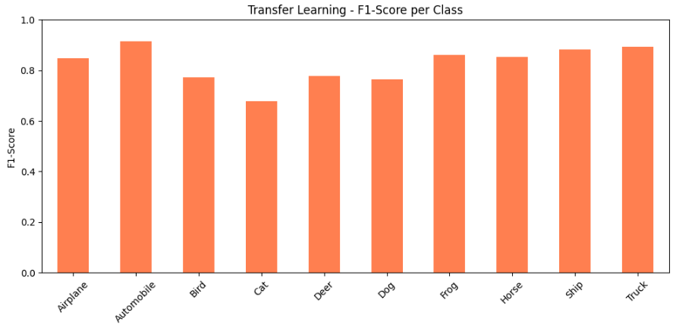
EVALUATION ON F1 SCORES
CNN BASE MODEL
FINE TUNING
TRANSFER LEARNING
Notes:
Base model: MobileNetV2(weights='imagenet', include_top=False)
Added custom head:
Global Average Pooling Dense(128, activation='relu’)
Dropout(0.3) Dense(10, activation='softmax’)
Total layers: 158 (154 from base + 4 custom)
weights='imagenet' loads pre-trained weights (on ImageNet: 1.4M images, 1000 classes).
include_top=False removes the final classification layer (we'll add our own).
input_shape=(IMG_SIZE, IMG_SIZE, 3) sets the input size for CIFAR-10 (resized to 160x160 or 224x224, 3 channels for RGB).
🎯 Purpose: Use MobileNetV2 as a feature extractor, not a classifier.
Explanation:
Freezes all MobileNetV2 layers so they don’t get updated during training.
Saves time and prevents forgetting what it already learned from ImageNet.
base_model.output: Get the final feature maps from MobileNetV2.
GlobalAveragePooling2D():
Converts the feature maps (shape: H×W×C) to a single vector (1×1×C).
Reduces model size, prevents overfitting, and works better than Flatten() for CNNs.
Dense(128, activation='relu'): Adds a fully connected layer to learn new patterns.
Dropout(0.3): Randomly turns off 30% of neurons during training to reduce overfitting.
Dense(10, activation='softmax'): Final output layer with 10 nodes for the 10 CIFAR-10 classes.
Combines the input of MobileNetV2 and the new classification head into a complete

Slide 12

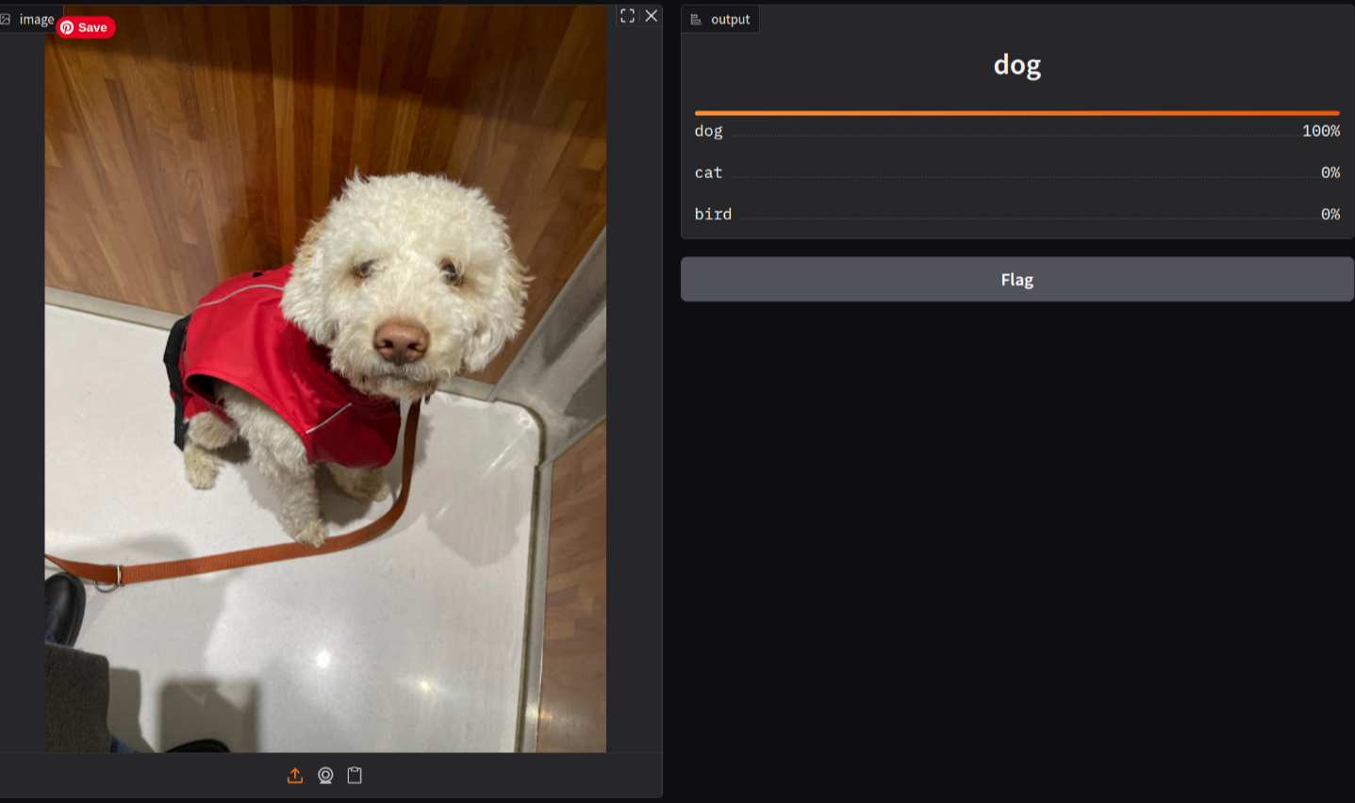
https://fecec6cb51659cd7c0.gradio.live/
Notes:
**Gradio App**:
- Upload an image
- Get top 3 class predictions with probabilities
**Flask API**:
- RESTful endpoint `/predict`
- Returns JSON with class probabilities

Slide 13
PROJECT OVERVIEW
Transfer learning significantly improved loss.
Fine-tuning further optimized performance.
Gradio made deployment simple and interactive.

